Slide 1

Learning Collaborative to Address Diabetes Prevention
High-Touch Coaching for Positive Change with Women of Color
Ifetayo Johnson, Senior Program Manager
Black Women’s Health Imperative
November 12, 2019
Notes:
Dani’s slide
Welcome

Slide 2
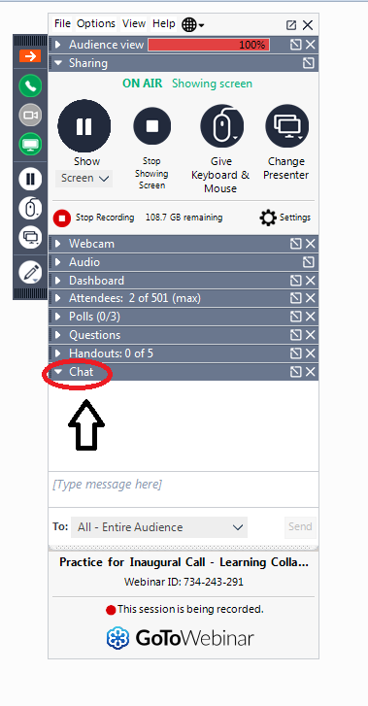

Housekeeping
Please stay in listen-only mode. You may unmute when it’s time for Q/A
This webinar will be recorded and shared at the end of January, along with some additional materials that are in development.
We will be asking open-ended questions to which you can type the answer into the chat box
If you have any questions please type them in the Q/A box and we will address them during the Q/A session.
ACPM will email the participants a brief feedback survey after the webinar

Slide 3
Audience Poll
Question
Where is your National DPP class located? Select All that apply
  Within the health system (in person or online)
  Outside the health system, within the community (in person or online)
  Referred to a lifestyle change class not recognized by CDC
  Not referred to any class at the moment
  Not sure

Slide 4


High-Touch Coaching for Positive Change
with Women
of Color

Slide 5
Who is this for?
Primarily designed to support Lifestyle Coaches and Coordinators who are serving or trying to serve
“hard-to-reach” populations enrolled in the
National Diabetes Prevention Program (National DPP)
Medical systems that refer women of color to the lifestyle change program
Administrations that want to see improved outreach, referral and retention among participants who are people of color
Those who are just curious about how we do our work

Slide 6
Black Women’s Health Imperative
Founded as the National Black Women’s Health Project in 1983 by renowned health activist and MacArthur Genius Byllye Y. Avery.
Only national organization dedicated to improving the health and wellness of our nation’s 21 million Black women and girls – physically, emotionally and financially
Priorities: Prevention of chronic conditions; sexual and reproductive health; breast and cervical cancer; and policy
and advocacy; leadership development on Historically Black Colleges and Universities (HBCUs).

Slide 7

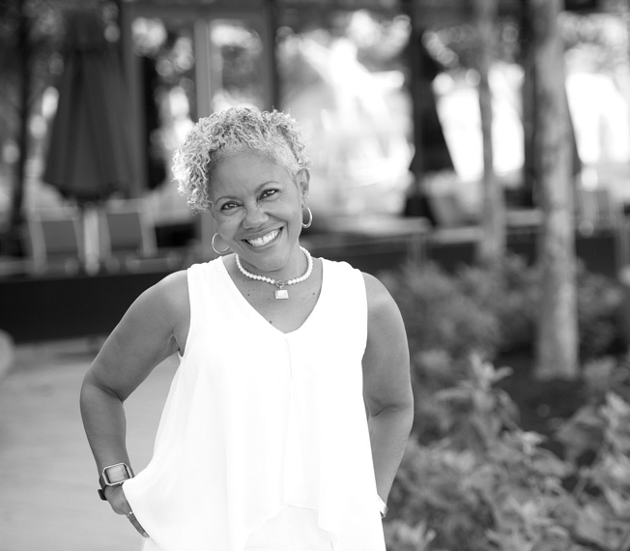
Black Women’s Health Imperative
One of the original national grantees funded by CDC to take the National DPP to scale in 2012 and funded again in 2017.
Proven success with enrolling, retaining and improving health of women of color in the program.
Developed a “High Touch Coaching” model to improve participant outcomes and retain them in the program.
CDC-designated Training Entity to provide new coach training, Master training, and advanced skills training to any program provider.
Provide tailored technical assistance to program providers through contracted services.

Slide 8







Our CYL² Program Partners

Slide 9
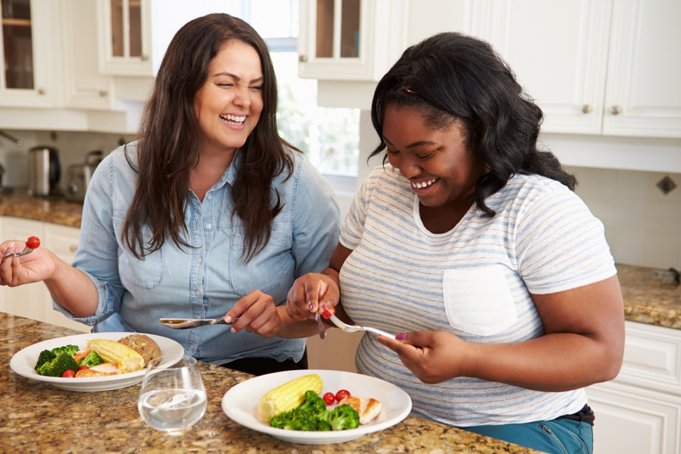
Unique Target Populations
Among all women in the United States, Black Women rank first in obesity.
Lantinas rank first in being overweight and second to Black women in obesity.

Slide 10
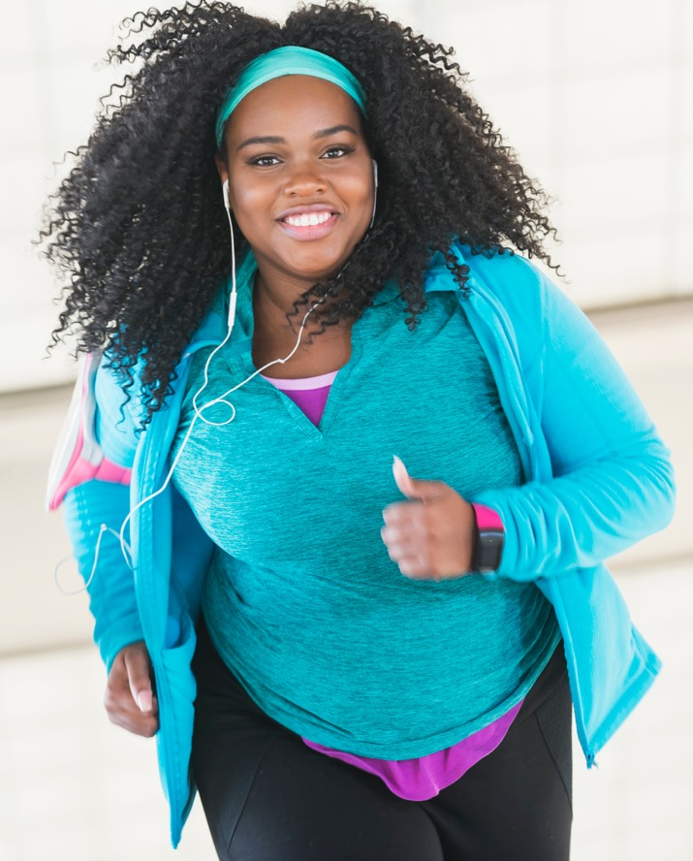
Black Women’s Health
Priority population: Black women and Latinas
Program delivered in English & Spanish
As of October 1, 2019:
Enrolled over 3400 participants
Retention rates as high as 88%
All our original 2012 partners have obtained full recognition and one of our new partners obtained full recognition on their first eligible submission.
Two of the other five have been notified of preliminary recognition on their first eligible submission. The other 3 await results.

Slide 11
Black Women’s Health Imperative DP12-1212 Weight Loss Analysis:
Eligible females¹ who attended 3 or more core sessions and completed at least 9 months of sessions
 | Average Weight Loss % (Non-BWHI orgs) | Average Attendance in 12 Months (Non-BWHI orgs) | Average Weight Loss % (BWHI orgs) | Average Attendance in 12 Months (BWHI orgs)
Non-Hispanic Black | 4.4% | 20 | 5.7% | 21
18-44 | 4.2% | 20 | 6.9% | 21
45-64 | 4.4% | 20 | 5.4% | 21
65+ | 4.6% | 20 | 5.9% | 22
Non-Hispanic White | 6.1% | 21 | 8.0% | 21
18-44 | 5.4% | 21 | 6.4% | 22
45-64 | 6.0% | 21 | 8.6% | 21
65+ | 6.4% | 21 | - | -
Hispanic | 4.6% | 21 | 7.4% | 28
18-44 | 4.9% | 21 | 8.2% | 31
45-64 | 4.2% | 21 | 6.4% | 27
65+ | 5.1% | 20 | 8.4% | 26
Other² | 4.9% | 21 | 2.9% | 20
18-44 | 3.7% | 21 | 2.3% | 25
45-64 | 4.8% | 21 | 2.6% | 19
65+ | 5.4% | 20 | 6.3% | 10
  Only female participants from in-person programs were included.
  Other includes other races, multiracial, and not reported.
  Data Sources: DP12-1212 National Evaluation and Diabetes Prevention Recognition Program 10/01/2012-09/30/2017
Notes:
1 Only female participants from in-person programs were included.
2 Other includes other races, multiracial, and not reported.
Data Sources: DP12-1212 National Evaluation and DPRP, 10/01/2012-09/30/2017

Slide 12
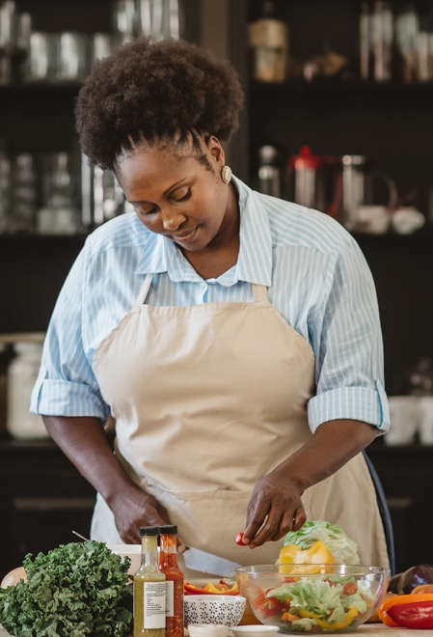
Black Women’s Health Imperative DP12-1212 Weight Loss Analysis:
Eligible females¹ who attended 3 or more core sessions and completed at least 9 months of sessions
Non-Hispanic Black women have the lowest percent weight loss among non-BWHI organizations, while women of other race/ethnicity group
have the lowest percent weight loss among BWHI organizations.
Among non-Hispanic Black women in non-BWHI organizations, weight
loss increases as women age.
Hispanic and Non-Hispanic Black women in BWHI organizations report a higher percent average weight loss than those in non-BWHI organizations and achieved 5% weight loss goal across different age groups.
Overall female participants across different race/ethnicity groups have a high average attendance (average of 20 sessions or more attended).
  Only female participants from in-person programs were included.
  Other includes other races, multiracial, and not reported.
  Data Sources: DP12-1212 National Evaluation and Diabetes Prevention Recognition Program 10/01/2012-09/30/2017

Slide 13
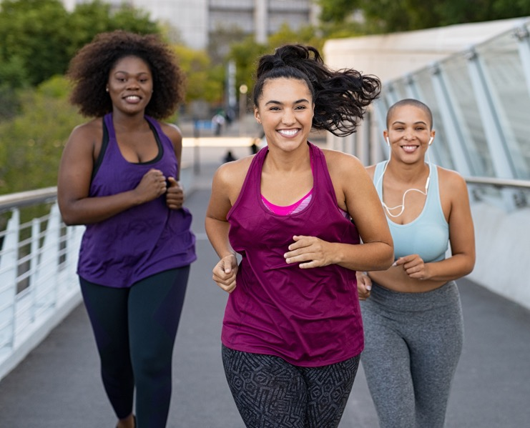
Black Women’s Health Imperative
DP12-1212 Weight Loss Analysis:
Eligible females¹ who attended 3 or more core sessions
and completed at least 9 months of sessions
Hispanic women in the BWHI organizations attend more sessions, on average, than Hispanic women in non-BWHI organizations.
For BWHI organizations, women of other race/ethnicity groups have lower average percent weight loss than those in non-BWHI organizations.
  Only female participants from in-person programs were included.
  Other includes other races, multiracial, and not reported.
  Data Sources: DP12-1212 National Evaluation and Diabetes Prevention Recognition Program 10/01/2012-09/30/2017

Slide 14
Audience Poll
Question
Are you familiar with the concept of high touch coaching model?
  Yes
  No
  Not Sure

Slide 15
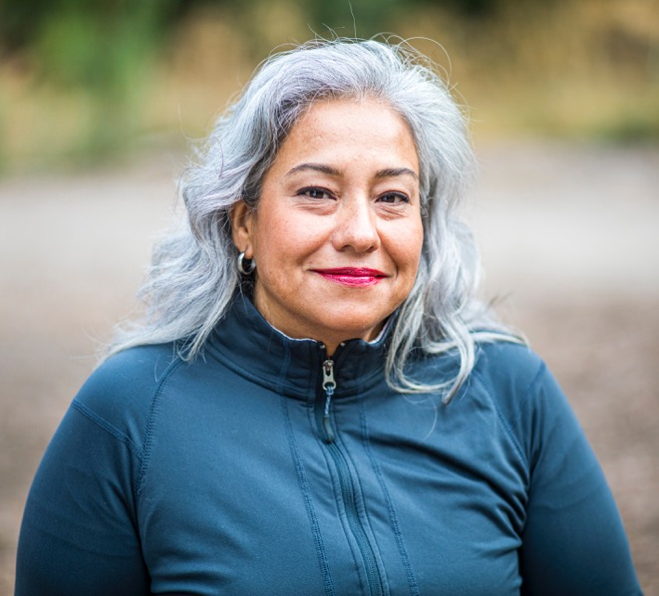
How did High-Touch Coaching Evolve?
It began with the struggles we faced as 1212 affiliates (BWHI’s five original program partners in 2012)
Like other programs across the country, Black women and Latinas were losing less weight than their counterparts in DPP
This was over 97% of our population
Sharing best practices resulted in improved results
Began to codify our approach

Slide 16
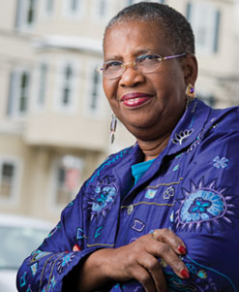
“Change brings about such mixed feelings: excitement, fear, joy.
Change provides us with experiences that we convert into personal power. change is a challenge that provides us with opportunity to grow”.
– Byllye Avery, Alter of Words

Slide 17
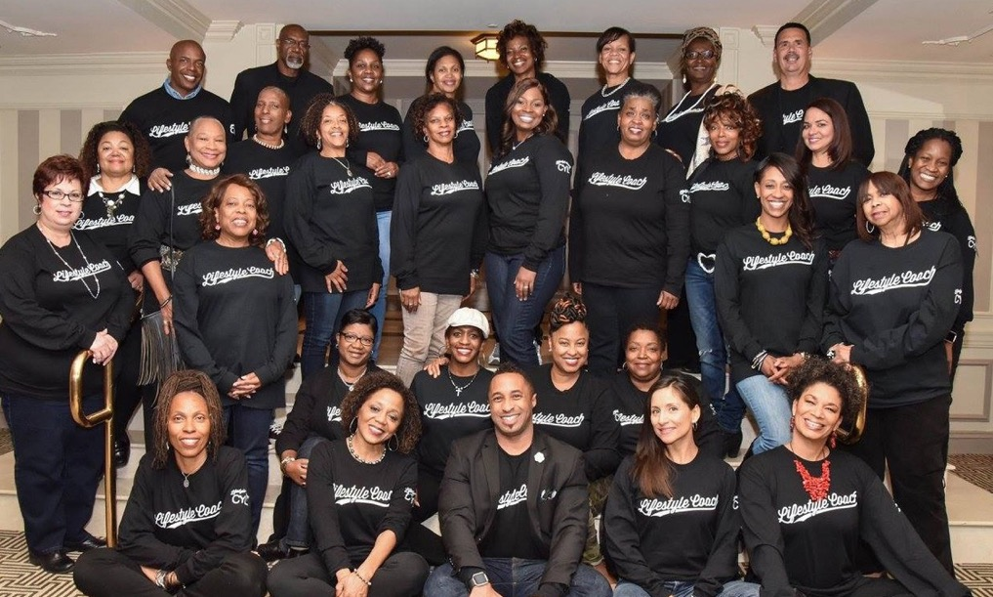
Change Was What We Needed
How do we differ?
More personalized approach
Based on relationships and trust
Cultural sensitivity
Focus on three major components in the lives of women of color

Slide 18
We specialize in women of color who daily face the impact of:
Stress
Lived Experience
Intersectionality

Slide 19
High-Touch Coaches Relate
High-Touch coaches are empathetic, compassionate and share many of the lived experiences of their participants.
Help participants explore, navigate, understand, and change their circumstances.
Begin with self-awareness

Slide 20
Our coaches do not require participants to change who they are but to realize they are worthy and capable, and because they are, they have everything they need to meet their goals.
We become what we believe
Reassurance and
Self-fulfilling Prophecy

Slide 21
The 10 Pillars
of BWHI
High-Touch
Coaching Model

Slide 22


High-Touch coaches embrace their uniqueness and do their own reflection and self-assessment
Actually, the first step to HTC
Each LC must identify their own unique strengths, talents, interests that can be used to connect to participants and enhance the group’s experience
Take the time to reflect on our own struggles, challenges and ways we have overcome them
Exam our own biases, beliefs and desires

Slide 23

Respect for the lived experience of women of color influences all aspects of their lives
Our day-to-day existence is a continuous state of challenge
Stress is higher
Systemic concerns
Micro-aggressions
Implicit and explicit biases
Myths
Joy of family/community
Foundational beliefs/faith
Hope for the next generation
Strong traditions
Resilience

Slide 24

Awareness of how intersectionality can create a bigger challenge for women of color.
Sexism impacts
Racism impacts
Socioeconomic status impacts
Ageism impacts
Zip code - ism

Slide 25

Thoughtful, authentic and patient-centered engagement that builds trust and credibility
“Navigate” participant from referral to enrollment (identify barriers)
Placing the participant first
Authenticity is apparent and transparent
Trust is foundational
Grows over time
Improves with each cohort
Trust transfers

Slide 26

Personalized/customized learning in response to diverse personalities, learning styles, and needs
Traditional classrooms – left brain, lecture centered
Generally are more right or whole brain thinkers
Need to facilitate in different learning quadrants
  VARK model, identifies four primary types of learners:
  visual, auditory, reading/writing, and kinesthetic.
Try to present all major learning objectives in all four styles

Slide 27

Cultural and linguistic tailoring of program content, strategies, and actvities
Show me – me
Learn the culture of participants from them
Tailor delivery, examples, and solutions to fit
Be mindful of limitations and assumptions of resources

Slide 28

Creating a safe space for women to be reflective, self-assess and find their own solutions for change
Safety must include physical, mental and emotional space
Unconditional positive regard
Confidentiality
Non-judgmental space (coach and cohort)
Room to explore and share without fear or repercussions

Slide 29

The participant’s voice is the
most important voice
The importance of being seen and heard
Learning to speak up and out for self
Placing self first, setting others aside for an hour
All the answers are in the room
My voice matters

Slide 30

Accessible and consistent support and referrals to other resources
The ability to contact and connect with LC and cohort
Setting parameters and expectations
Being the friend rather than instructor or expert
Bringing resources that match the need
Supporting, acknowledging, and celebrating lifestyle changes

Slide 31

High-Touch Coaching is about building relationships
Relationships are time intensive
Great relationships may build slowly but steadily
Expect to be tested
Pass the test
Under promise and over deliver
Show integrity
Listen
CARE deeply

Slide 32

Now What?
We don’t recommend trying to implement the
High-Touch Model without training.
Suggest hiring, training, and utilizing coaches who represent the culture of the groups you are trying to reach and have them also work with other coaches.
Feel free to contact BWHI for information on training (info on last slide).
High-Touch Training Manual will be available in the Spring of 2020.

Slide 33
Audience Open
Question
What are some of the challenges that your coaches/DPP Coordinators encounter while engaging or retaining patients with pre-diabetes in the National DPP class?
Type your answers in the Chat box

Slide 34
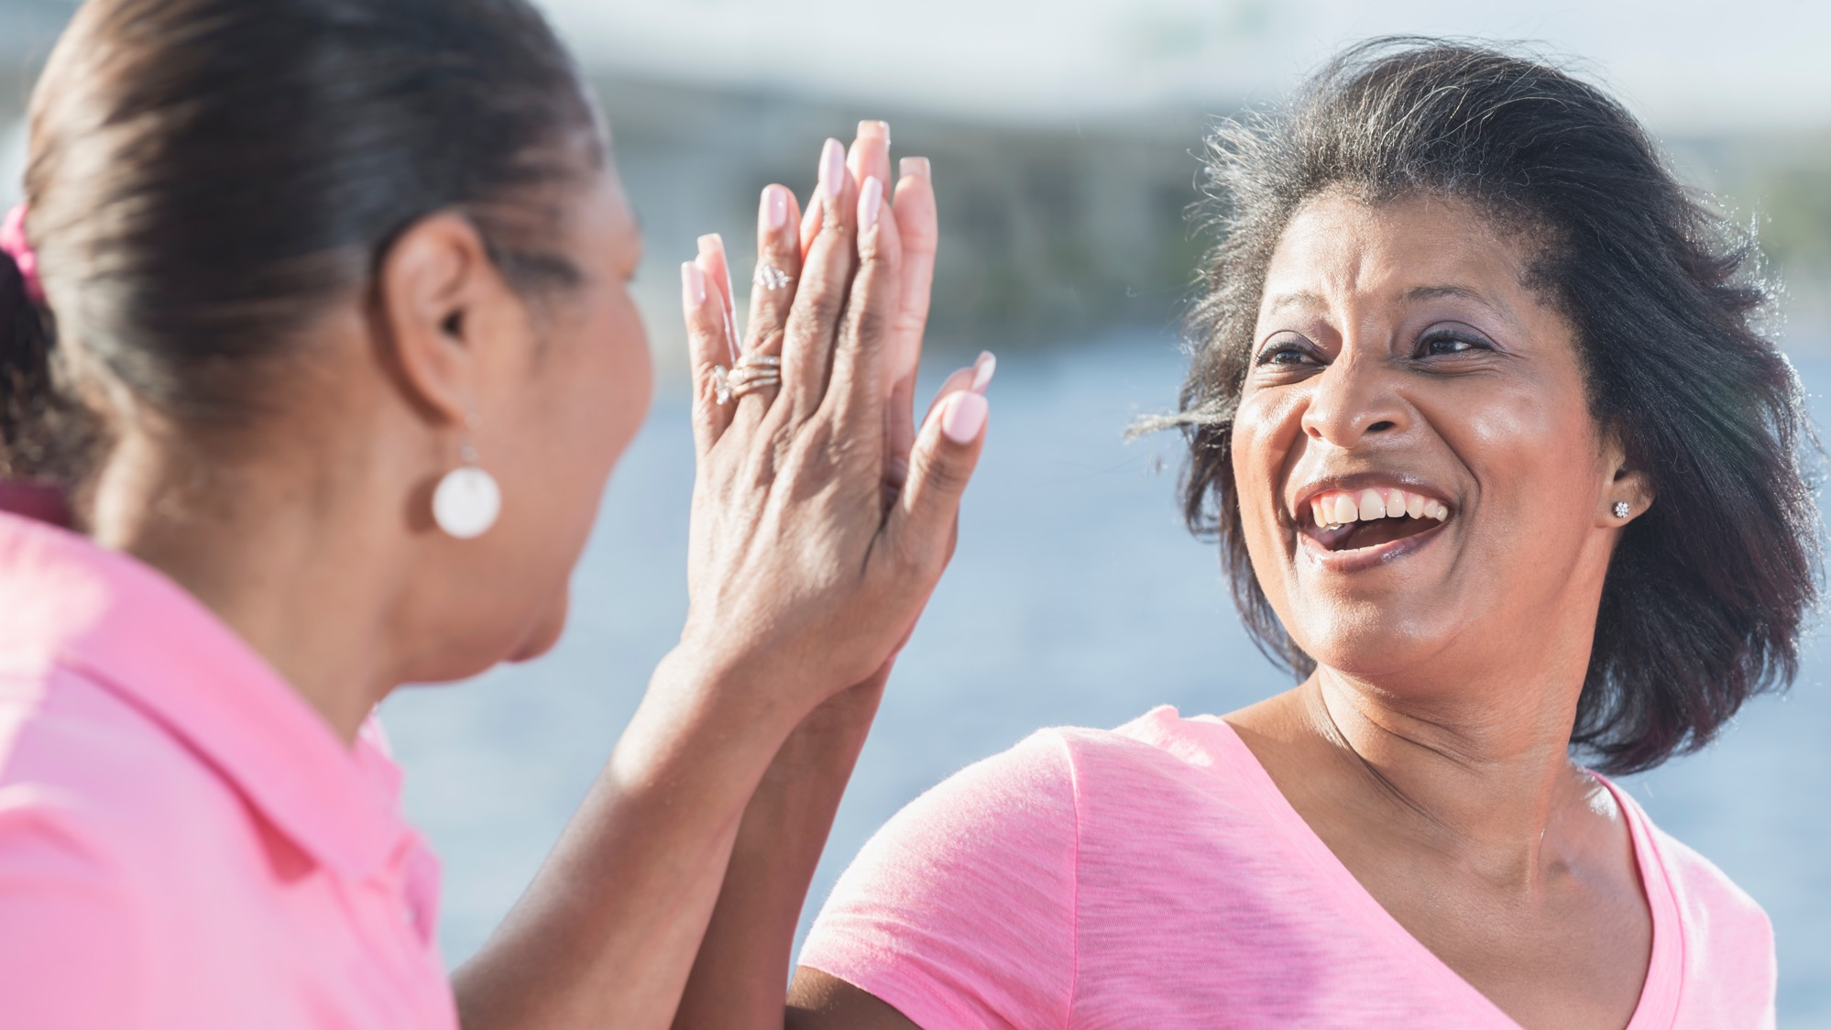
Questions?

Slide 35
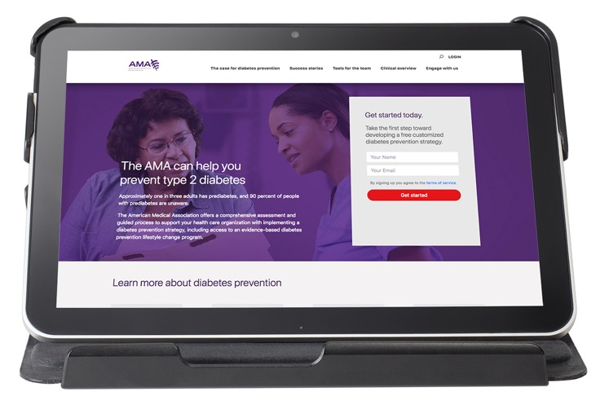

AMA Digital Guide
Step-by-step guidance to implement a diabetes prevention strategy, including a personalized project plan and dashboard
Content related to diabetes prevention including:
  Real-life experiences with diabetes prevention
  Profiles of current health care organizations
  Patient handouts on prediabetes
  The National DPP lifestyle change program, and more
Free access to best practice solutions, tools and resources to assist with planning and executing a diabetes prevention strategy
amapreventdiabetes.org
Notes:
If time allows after Q/A:
Remind organizations to take AMA digital assessment on amapreventdiabetes.org

Slide 36
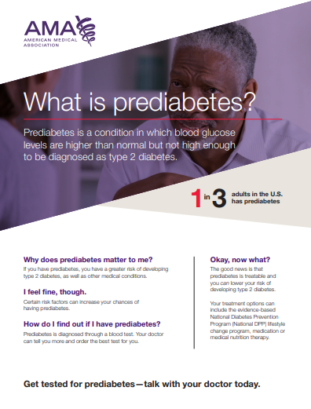
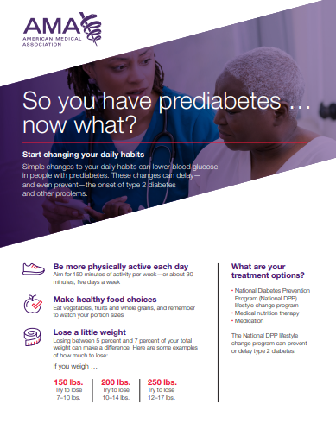
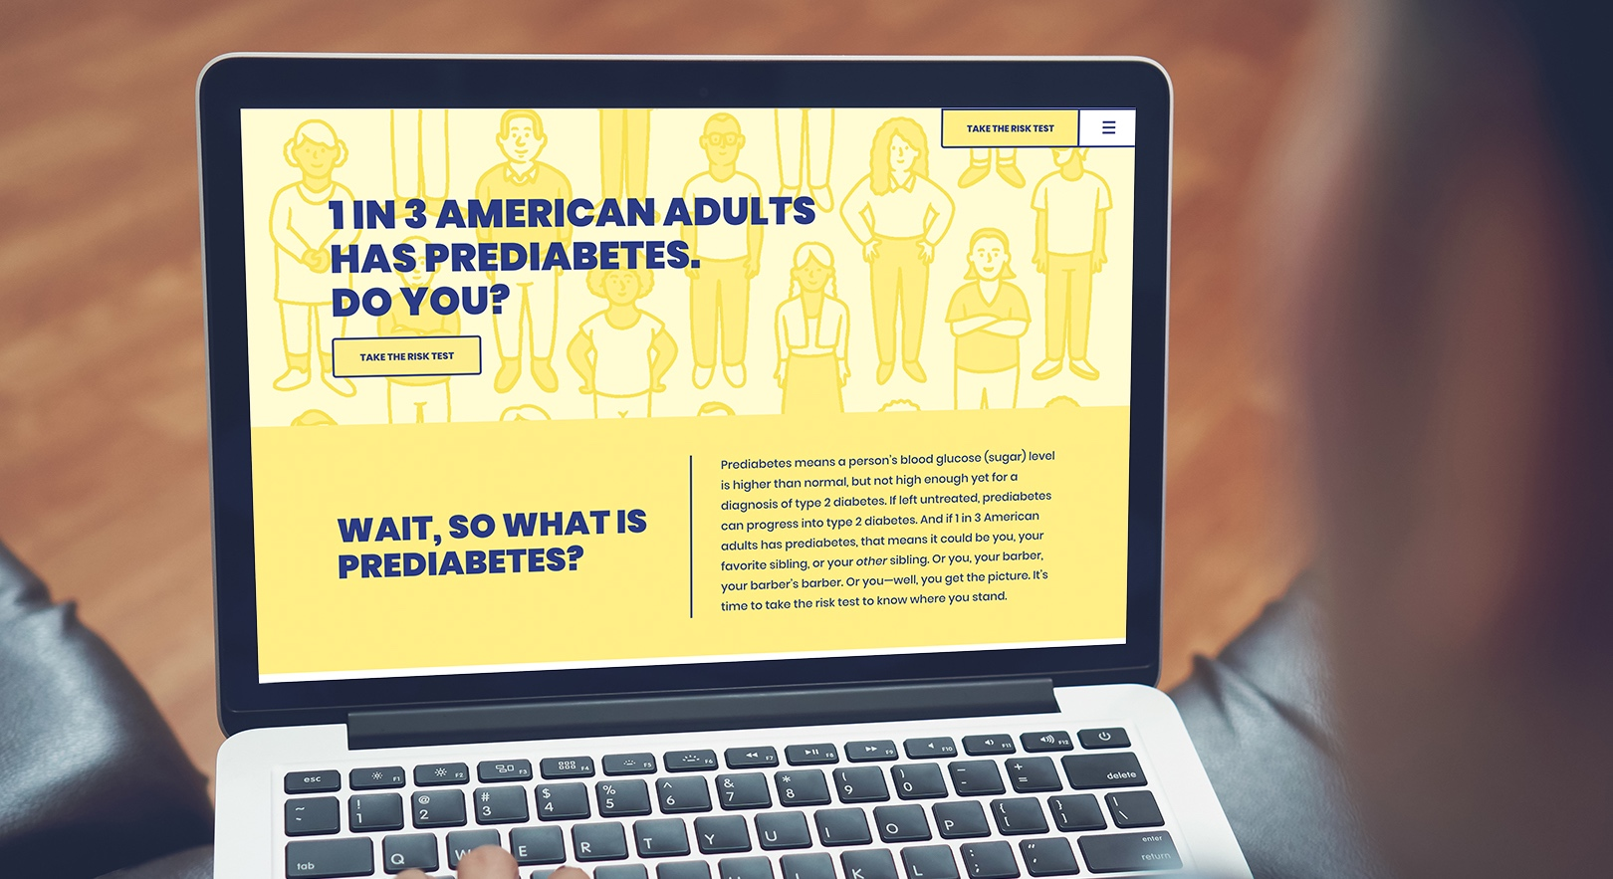
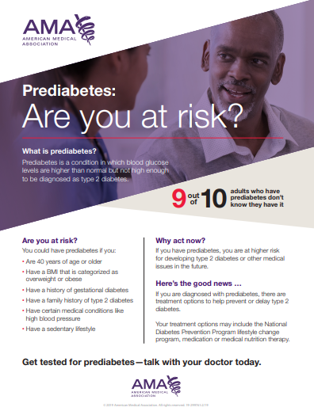
Identify communication and messaging
DoIHavePrediabtes.org
Know Where You Stand.
Take the one-minute risk test today.
Notes:
Next, you will want to incorporate a multi-pronged patient outreach and communication strategy. The purpose of this is to increase awareness that prediabetes is a treatable and often reversible condition, as well as educate your patients on treatment options and the goals of treatment.
Increasing awareness throughout the community of prediabetes as a condition is the first step to diabetes prevention. A great place to start is by partnering with your organization’s marketing or communications team to create a general awareness campaign.
You will also want to initiate patient communication based on the approach you landed on to identify patients, either at the Point of Care or through Care Management.
Example patient facing materials, in both English and Spanish, can be found on amapreventdiabetes.org. That is what I have showcased on the left-hand side of the screen. In addition, Doihaveprediabetes.org also has fantastic patient facing materials which I would encourage you to leverage.

Slide 37
Closing Items
This webinar will be recorded and shared at the end of January, along with some additional materials that are in development.
The second webinar will take place in February 2020; look for a save-the-date in January.
We appreciate your feedback! Please complete the survey that will be e-mailed out.
Notes:
Survey provides us with valuable feedback

Slide 38

For more information: Visit our website at BWHI.org
Contact
Ifetayo Johnson, Senior Program Manager at ijohnson@bwhi.org
or
Dr. Angela Ford, Chief Program Officer at aford@bwhi.org
Thank you!

